Slide 1

CyberLoop
Group Members :-
DIVYAM RAJ - 202410116100066
GAURAV CHAUHAN - 202410116100073
GAURAV KUMAR -202410116100074
HARSH SOLANKI -202410116100087
Project Supervisor :-
Mr. Apoorv Jain
Assistant Professor, KIET Group Of Institutions.

Slide 2

Multimodal Sentiment Analysis: Text + Image
Multimodal Sentiment Analysis is about understanding people's emotions or opinions by analyzing multiple types of data — usually text and images together.
Instead of just looking at text (like a tweet) or just an image (like a meme), this project combines both to understand the sentiment (positive, negative, or neutral).
This presentation delves into the exciting field of multimodal sentiment analysis, focusing on how combining text and image data can lead to a deeper understanding of human emotions. We'll explore the methodologies, challenges, and compelling results of our recent AI project.

Slide 3


What is Multimodal Sentiment Analysis?
Integrating Data
Holistic Understanding
Multimodal sentiment analysis is an advanced artificial intelligence technique that goes beyond traditional text-based approaches by incorporating visual information. It combines data from both text and images to form a more comprehensive understanding of expressed emotions.
This method analyzes the emotions expressed in both modalities simultaneously. By considering how words complement or contradict the visual cues in an image, the system gains a richer context, leading to a more nuanced and accurate interpretation of sentiment.

Slide 4




Why Multimodal?
Text Alone is Insufficient
Images Provide Crucial Cues
Relying solely on text often yields limited accuracy, typically around 70%. Text struggles with nuance, especially in informal contexts like social media where implied meanings are common.
Visual elements offer significant emotional cues that text cannot convey. A smiling face, a scenic background, or even specific gestures can dramatically alter the perceived sentiment of accompanying text.
Improved Accuracy
Handles Nuance
Multimodal analysis significantly boosts accuracy, showing improvements of 15-20% over text-only models. This is due to the complementary nature of the data, providing a more complete picture.
The combined approach excels at recognizing sarcasm, irony, and complex emotional expressions that are often missed by single-modality systems. The visual context often reveals the true intent.

Slide 5
Challenges in Multimodal Analysis
Computational Complexity
Handling Noise
Modality Alignment
Filtering irrelevant or misleading data from either modality is critical. A busy background in an image or irrelevant hashtags in text can introduce noise that degrades model performance, requiring robust preprocessing.
Data Integration
Image processing and the subsequent integration with text data demand substantial computational power and resources. Training and deploying such models often require powerful hardware and optimized algorithms.
Connecting related elements across text and images is crucial. For instance, identifying if a specific word in the text refers to an object or person visible in the image is complex but vital for accurate analysis.
A key challenge is effectively combining distinct text and image features into a unified representation. This requires sophisticated techniques to ensure information from both modalities is equally weighted and understood.

Slide 6
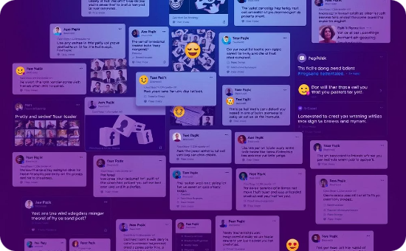
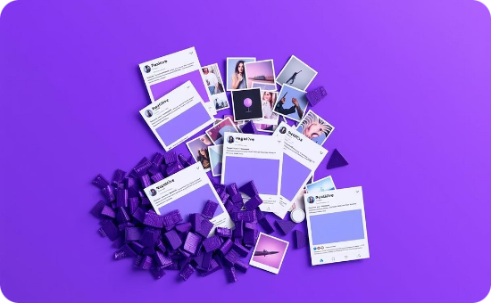
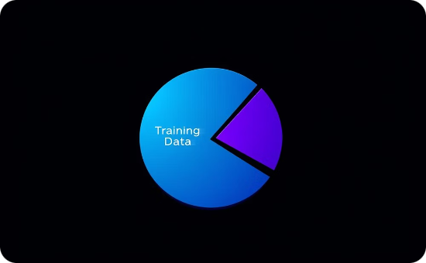
Project Overview: Data Collection
Dataset Size
Balanced Classes
Data Split
Our project utilized a custom dataset comprising 5,000 social media posts. Each post included both textual content and an accompanying image, reflecting real-world multimodal data.
To ensure robust model training and prevent bias, the dataset was carefully curated to have balanced classes: positive, negative, and neutral sentiments were represented equally.
The dataset was divided into a standard 60/20/20 split for training, validation, and testing respectively. This ensures that the model is trained on a large portion of data, fine-tuned on a separate validation set, and evaluated on unseen data.

Slide 7



Project Overview: Feature Extraction
Text Features: BERT
Image Features: ResNet-50
Transfer Learning
For text analysis, we leveraged pre-trained BERT (Bidirectional Encoder Representations from Transformers) embeddings. These provide a rich, contextualized representation of words, capturing semantic meaning and relationships within sentences, outputting a 768-dimensional vector.
Image features were extracted using a pre-trained ResNet-50 model. ResNet-50 is a deep convolutional neural network known for its strong performance in image recognition tasks, providing high-level visual features in a 2048-dimensional vector.
Both BERT and ResNet-50 were used for transfer learning, where their pre-trained weights on massive datasets allowed us to extract powerful features without training complex models from scratch. This significantly reduced training time and improved performance on our specific task.

Slide 8




Project Overview: Model Architecture
Feature Concatenation
The extracted BERT (text) and ResNet-50 (image) features were concatenated. This creates a single, unified vector representing the combined textual and visual information, serving as the input for the subsequent layers.
Fully Connected Layers
Following concatenation, the unified features passed through a series of fully connected (dense) layers. These layers are responsible for learning complex patterns and relationships within the combined data to make the final sentiment prediction.
Dropout Regularization
To combat overfitting, a dropout regularization layer with a probability (p) of 0.5 was incorporated. This randomly deactivates a fraction of neurons during training, preventing the model from becoming too reliant on specific features.
Optimization
The model was optimized using the Adam optimizer, a popular and effective algorithm for stochastic gradient descent. A learning rate of 0.001 was chosen to ensure stable and efficient convergence during training.

Slide 9
Results: Performance Metrics
88%
89%
Accuracy
Precision
Our model achieved an impressive 88% accuracy on the unseen test set, indicating its strong ability to correctly classify sentiment across positive, negative, and neutral categories.
With 89% precision, the model demonstrates a high rate of true positive predictions. This means that when it predicts a certain sentiment, it is very likely to be correct.
87%
88%
Recall
F1-score
The model's recall of 87% signifies its effectiveness in identifying all relevant instances for each sentiment class. It successfully captured a high proportion of actual positive, negative, and neutral sentiments.
The F1-score of 88% represents the harmonic mean of precision and recall, providing a balanced measure of the model's overall performance, especially useful for imbalanced datasets (though ours was balanced).
These robust metrics showcase a significant improvement of 10% over our baseline text-only model, validating the power of multimodal analysis in sentiment detection.

Slide 10
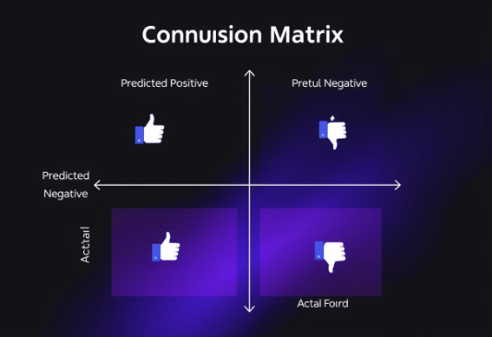
Results: Error Analysis
Sarcasm Remains Tricky
Future Work
Despite improvements, sarcasm and irony continue to be difficult for the model to detect consistently. These expressions often rely on subtle textual and visual contradictions that are hard for AI to fully grasp.
Future iterations will explore incorporating more contextual data, such as user profiles, historical interactions, and broader topic understanding, to further enhance the model's ability to interpret complex and nuanced expressions.
For example, an image of a person smiling while the text reads "What a fantastic day, truly thrilled to be stuck in traffic!" might be misclassified if the model over-indexes on the smile.
Confusion Matrix Insights
Analysis of the confusion matrix revealed specific areas where the model struggled, particularly with distinguishing between neutral and mildly positive/negative sentiments. This suggests subtle cues are still challenging.

Slide 11

Conclusion
Our project definitively demonstrates that multimodal sentiment analysis, by integrating both text and image data, provides significantly better results than single-modality approaches. This combined understanding opens new doors to a much more nuanced and accurate interpretation of emotional expressions.
The potential applications of this technology are vast. From enhancing brand monitoring by understanding public perception more deeply, to improving customer service by identifying emotional distress in user interactions, and providing more precise social analytics, multimodal sentiment analysis is set to revolutionize how we understand digital communication.

